Slide 1
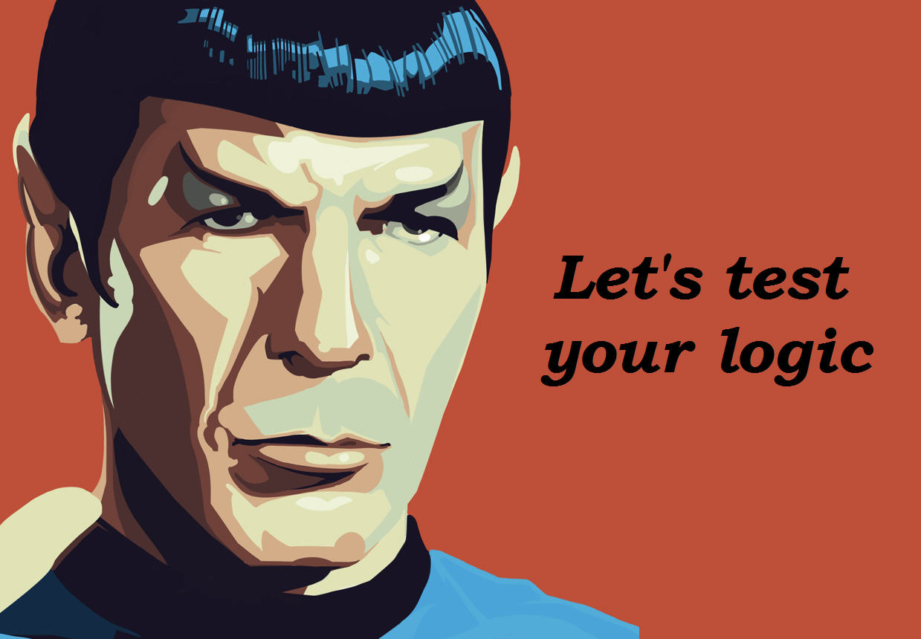
Spock – A better way to Unit Test
KC Java User Group
By
Dan Dowma

Slide 2
About Me
Java programmer for 15+ years
Groovy programmer for 2 years
Used all the popular frameworks over the years
ATG Dynamo, Struts, Spring, Camel
Grails, Spock

Slide 3
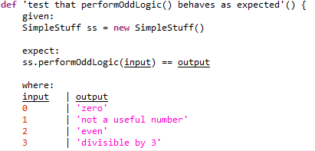
Spock Basics
Expect/Where
Tabular definition of expectations
When/Then
Logic block followed by assertion block

Slide 4
Useful links
Start here
https://code.google.com/p/spock/wiki/GettingStarted
https://code.google.com/p/spock/wiki/SpockBasics
Advanced examples
http://docs.spockframework.org/en/latest/interaction_based_testing.html

